Slide 1
BookWorm university library web application
TEAM MEMBERS:
David Brunner, Zachary Taylor, Kaiden Gallardo, Sam Salinas, Joseph Egan

Slide 2
Objective
Develop an interactive library platform
Ideally designed for educational institutions for students by students
Some key features include:
Easy access to a variety of online material (databases, books, articles, etc.)
Useful tools such as book annotation, bookmarking, etc.

Slide 3
Costs
PROJECTION OF COSTS:
Cost for staff during development is $24,570
$273/hr for entire team
$65/hr for manager
$52/hr for developer
Hardware Cost is $2,000
5 Desktops
Software Costs is $10,184/month
$10,000/month for Database
50TB storage
25TB download data per month
$100/month for dedicated server
$84/month for GitHub Enterprise

Slide 4
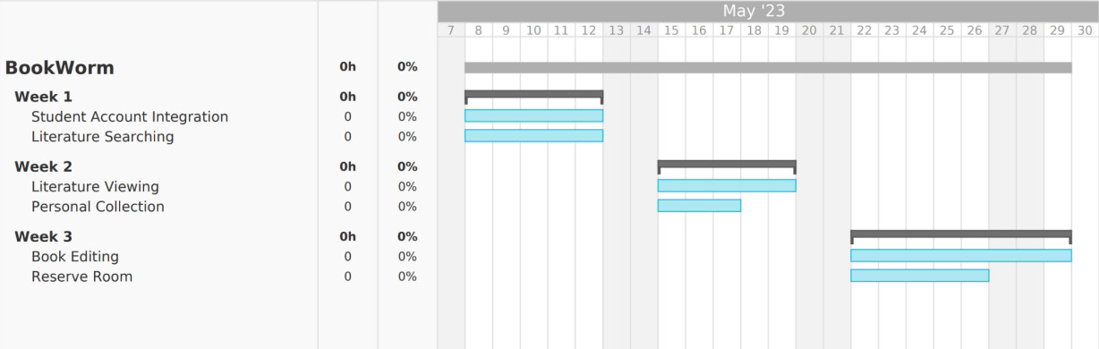
Timeline
Project Planning
App Development (2-3 Weeks)
Release

Slide 5
Requirements
FUNCTIONAL
NON-FUNCTIONAL
Authenticated users should be able to:
Login and Pay Fines
Search for, View, and Download specific databases, articles, and books
Create a Personal Collection of books and be able to Edit them
Reserve a Study Room by date and size
Safety / Security- All databases, articles, and books must be scanned for malware/viruses beforehand to ensure that users are not exposed
Regulatory - All databases, articles, and books must be checked for their relation to academics in some way shape or form to be kept in the repository

Slide 6
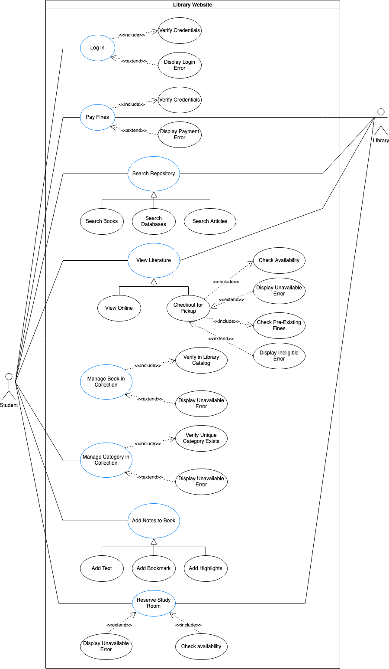
Use case diagram

Slide 7
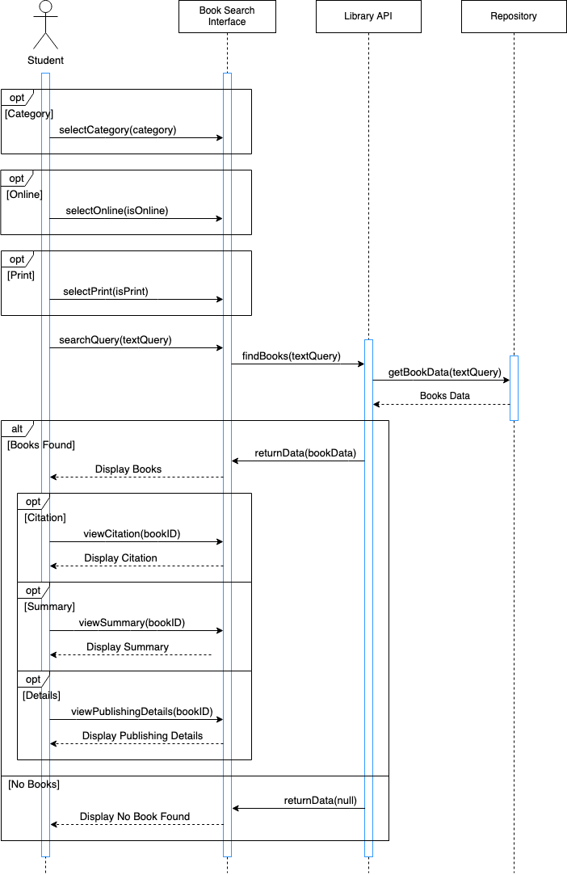
Sample Sequence Diagram

Slide 8
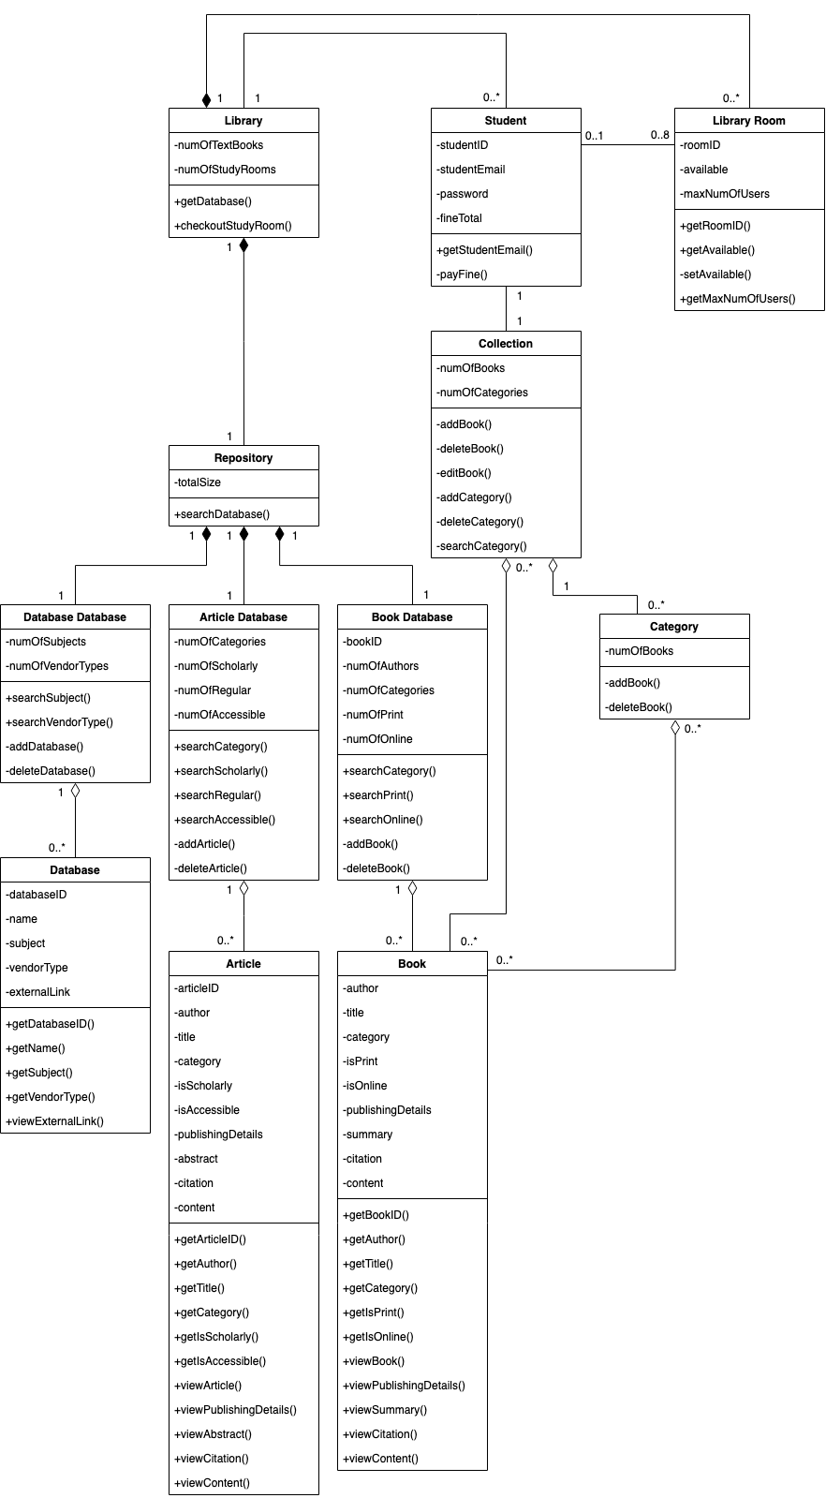
Class Diagram

Slide 9
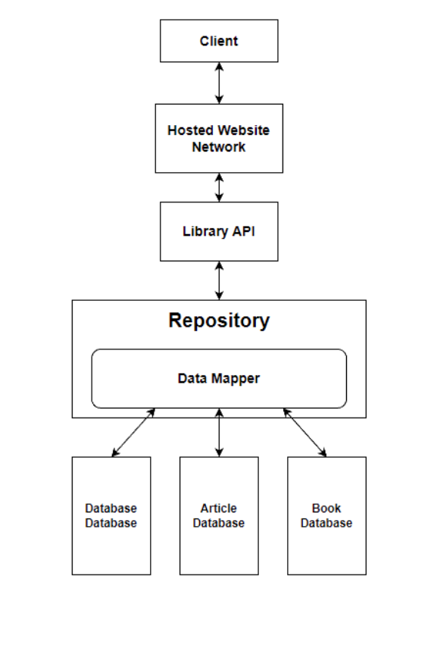
Repository Architectural Design

Slide 10
Thank You
If you have any questions, please ask!

